Slide 1
E-Commerce Analytics Dashboard
Capstone Project – Excel, SQL & Power BI
Prepared by: Ganesh K

Slide 2
Project Overview
Developed an E-Commerce Dashboard using Power BI
Data Set: Microsoft Excel
Data Source: MySQL Database
Tool Used: Power BI
Domain: Online Retail (Amazon Model)
Objective: To develop an interactive E-Commerce analytics dashboard using Microsoft Power BI that converts raw sales data into clear business insights for improving revenue, customer experience, and operational efficiency.
Table Used: Analyze Sales, Customers, Products, Orders, Payment methods, Delivery Performance, Refund & Customer Feedback.

Slide 3
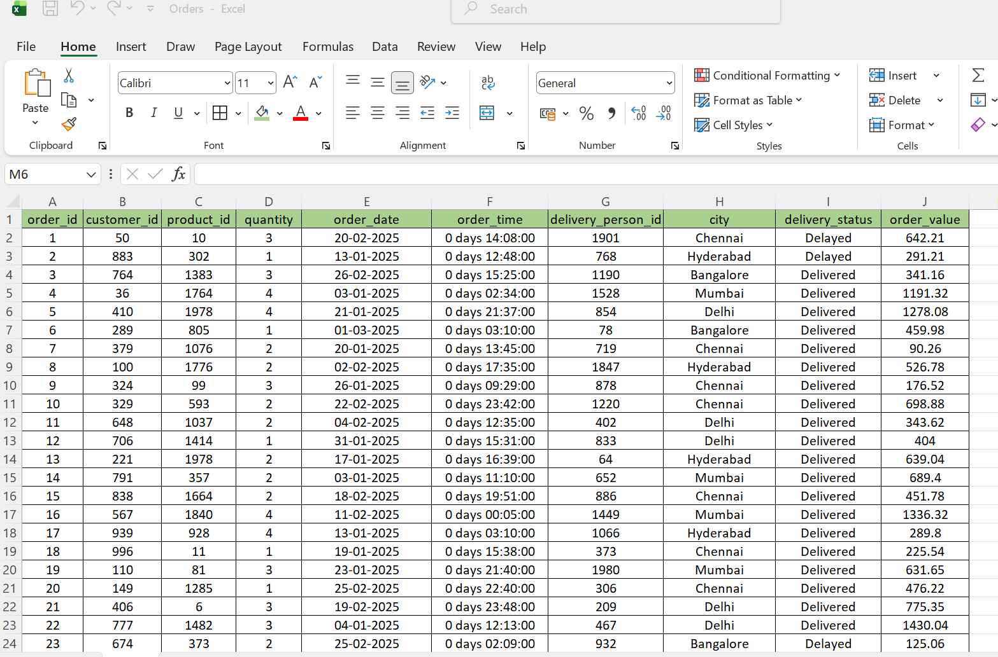
Data Set (Excel Sample)

Slide 4
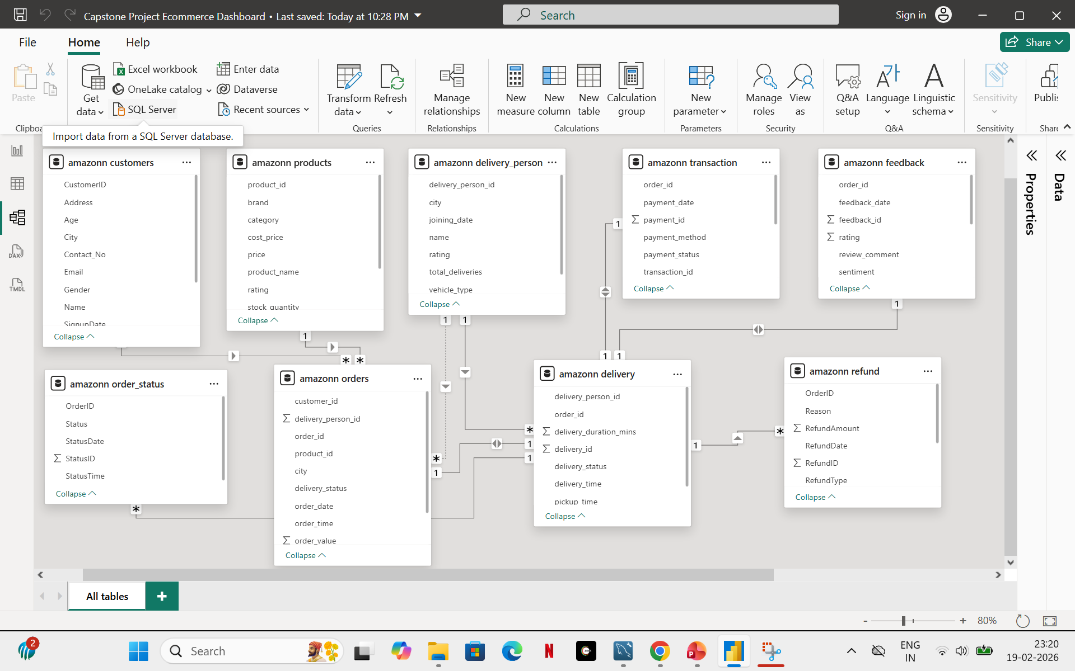
Data Model Design

Slide 5
DAX(Data Analysis Expressions)/Measure Key Metrics Used
Total Customers = count('amazonn customers'[CustomerID])
Total Revenue = sumx('amazonn orders','amazonn orders'[quantity] * RELATED('amazonn products'[price]))
Avg Sales = DIVIDE([Total Revenue],count('amazonn orders'[order_id]))
Avg Delivery Rating = AVERAGE('amazonn delivery_person'[rating])
Average Product Rating = AVERAGE('amazonn feedback'[rating])
Positive Count = CALCULATE(count('amazonn feedback'[feedback_id]), 'amazonn feedback'[sentiment] = "Positive")
Refund count = CALCULATE(COUNTROWS('amazonn refund'),'amazonn refund'[RefundType] = "Refund")

Slide 6
KPI(Key Performance Indicators)
Sales KPI:
Total Orders, Total Revenue, & Avg Sales.
Payment KPIs:
Total Payments, Successful payment, Failed Payment, & Successful & Failed payment %.
Delivery KPIs:
Average Delivery Time & Avg Delivery Rating.
Customer KPIs:
Total Customers, Top City of sales
Refund & Exchange KPIs:
Total Orders, Exchange count, Exchange % , Refund %, & Refund count.
Feedback KPIs:
Total Revenue, Avg Delivery Rating and Avg Product Rating.

Slide 7
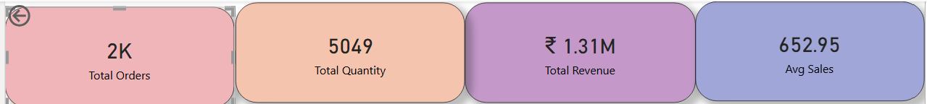
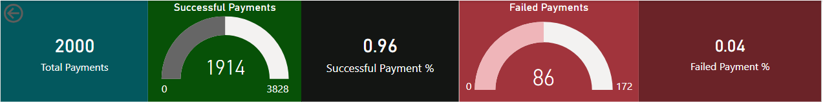
KPI Cards

Slide 8
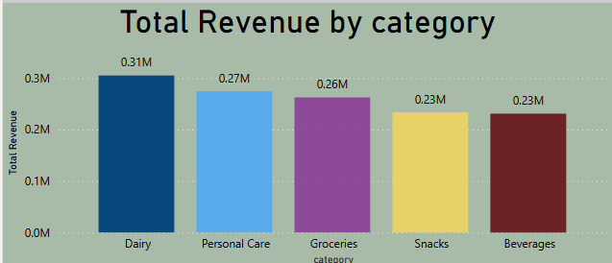
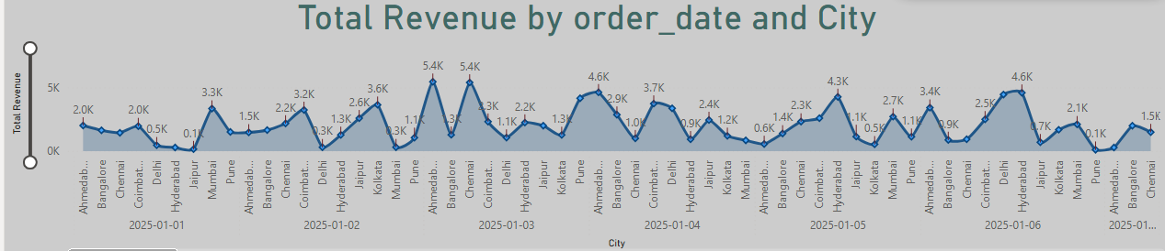
Sales Dashboard Charts

Slide 9
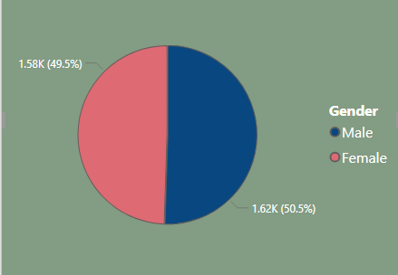
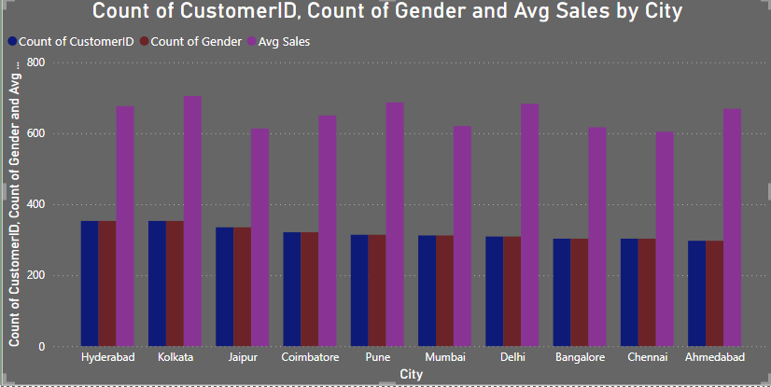
Customer Dashboard Charts

Slide 10
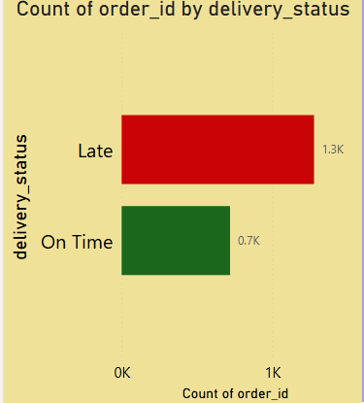
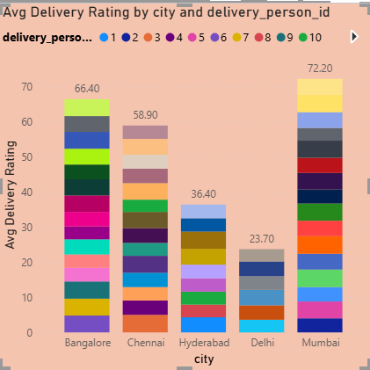
Delivery Performance Charts

Slide 11
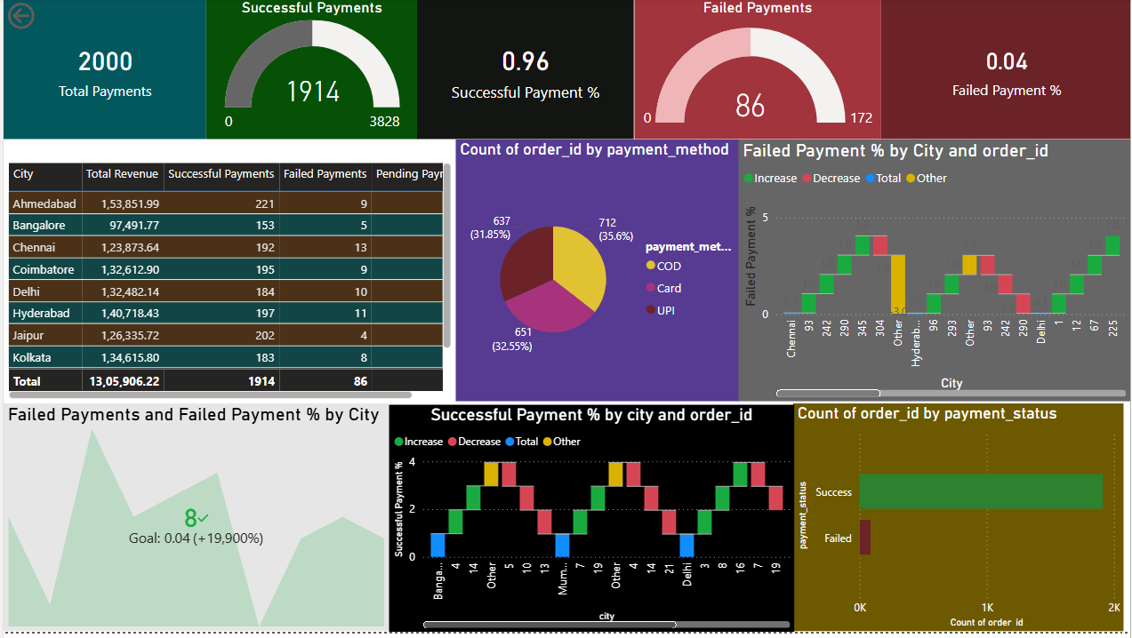
Payment Dashboard Charts

Slide 12
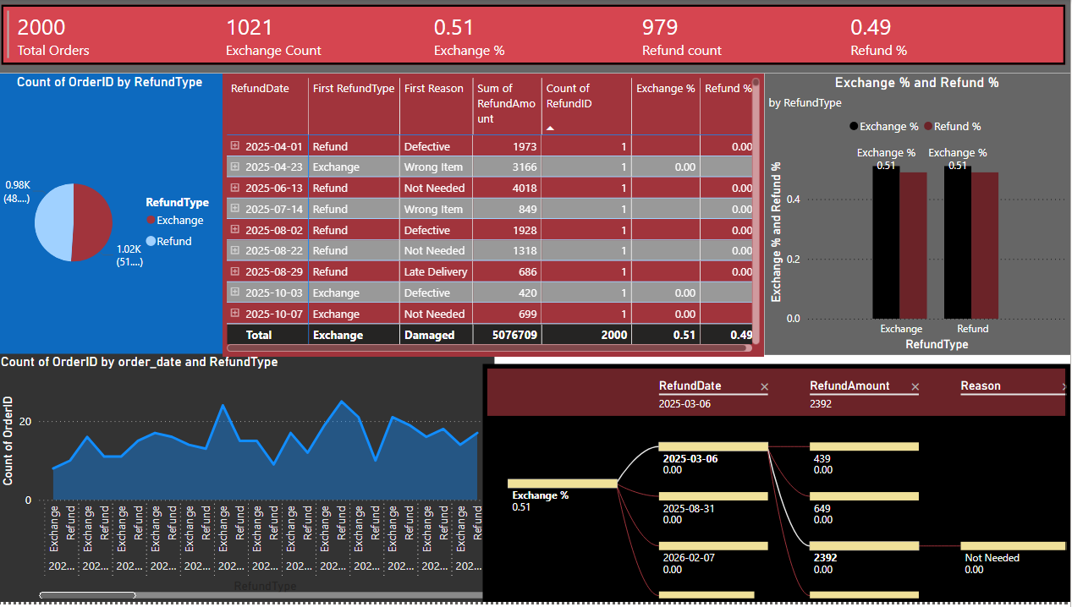
Refund & Exchange Dashboard

Slide 13
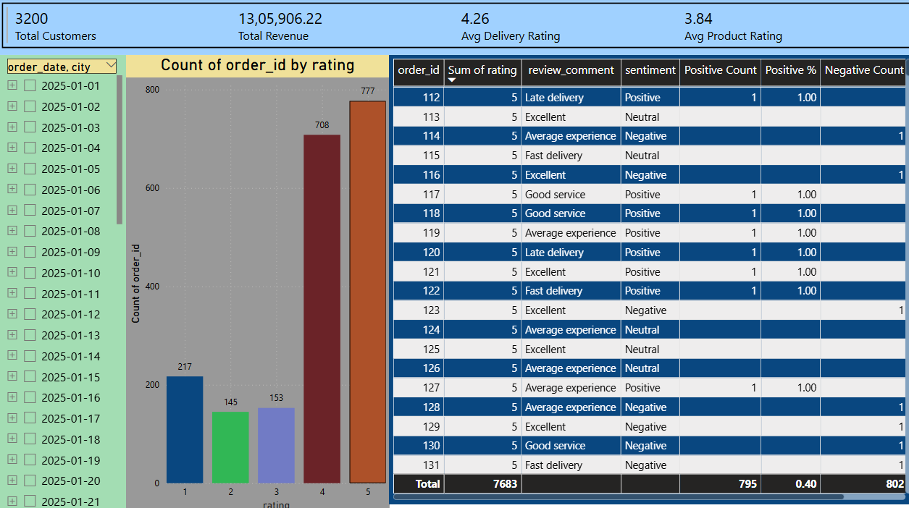
Customer Feedback Dashboard

Slide 14
Key Insights & Conclusion
• Identified high-performing product categories
• Analyzed customer buying patterns
• Improved delivery performance tracking
• Reduced refund impact through analysis
• Dashboard helps in strategic decision making

Slide 15
End-to-End Project Implementation
Presented by - Ganesh Kamalanathan

